Slide 1
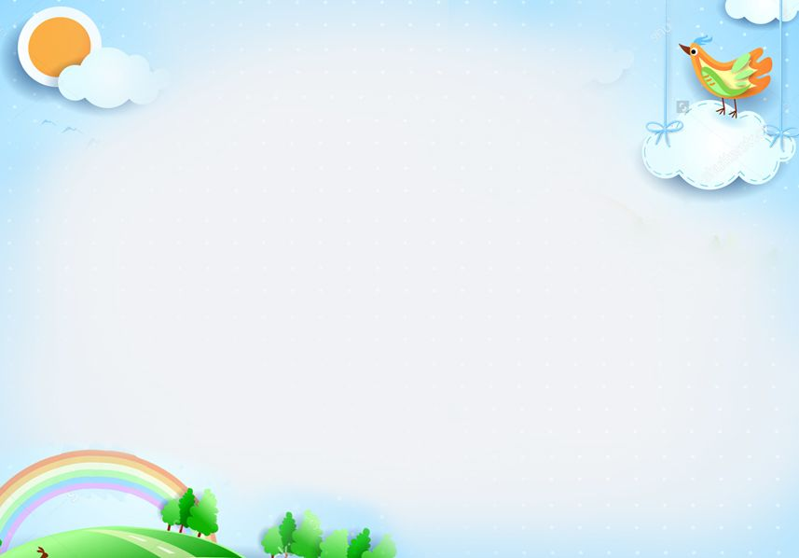
Hello everyone !!!

Slide 2
* WARM-UP
- What the child is doing?
- Is she behaving well at the table?
→ The child is inviting her grandparents before starting to eat.
→ Yes, she is.
That's the table manners
=> The polite ways of behaving when eating.
Can you give me some examples of table manners?

Slide 3
Can you give me some examples of table manners?
- Wait for the table arrangement before sitting down
- Wait for the oldest people to start first
- Pass your bowl with two hands
- Do not stick the chopstick against the bowl
- Do not flip the fish on the plate
- Do not point the chopsticks to anyone
- Do not dig into the dish
- Do not eat directly from shared dishes
- Stay until other people finish
- Say Thanks to the host after the meal

Slide 4
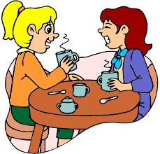
Unit
5
OUR CUSTOMS AND TRADITIONS
ETHNIC GROUPS OF VIET NAM
Unit
MUSIC AND ARTS
Unit
LESSON 4: COMMUNICATION
Unit
HOBBIES

Slide 5
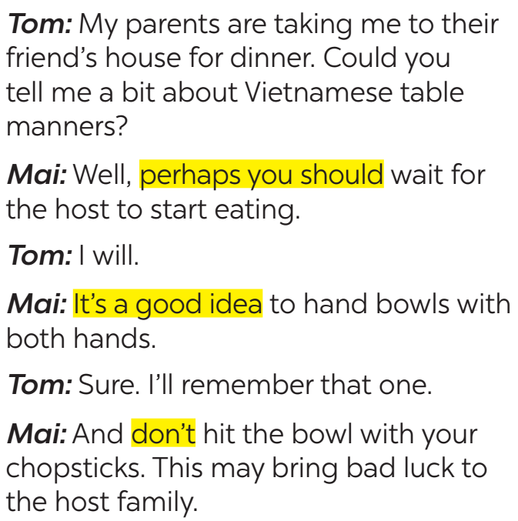
EVERYDAY ENGLISH
1
Listen and read the conversations. Pay attention to the highlighted sentences.
should do
should NOT do

Slide 6
EVERYDAY ENGLISH
-Perhaps you should + V₀
-It’s a good idea to + V₀
-Don’t + V₀
- Perhaps you should wait for the host to start eating.
- It’s a good idea to hand bowls with both hands.
- Don’t hit the bowl with your chopsticks.

Slide 7
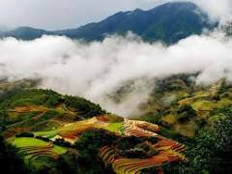
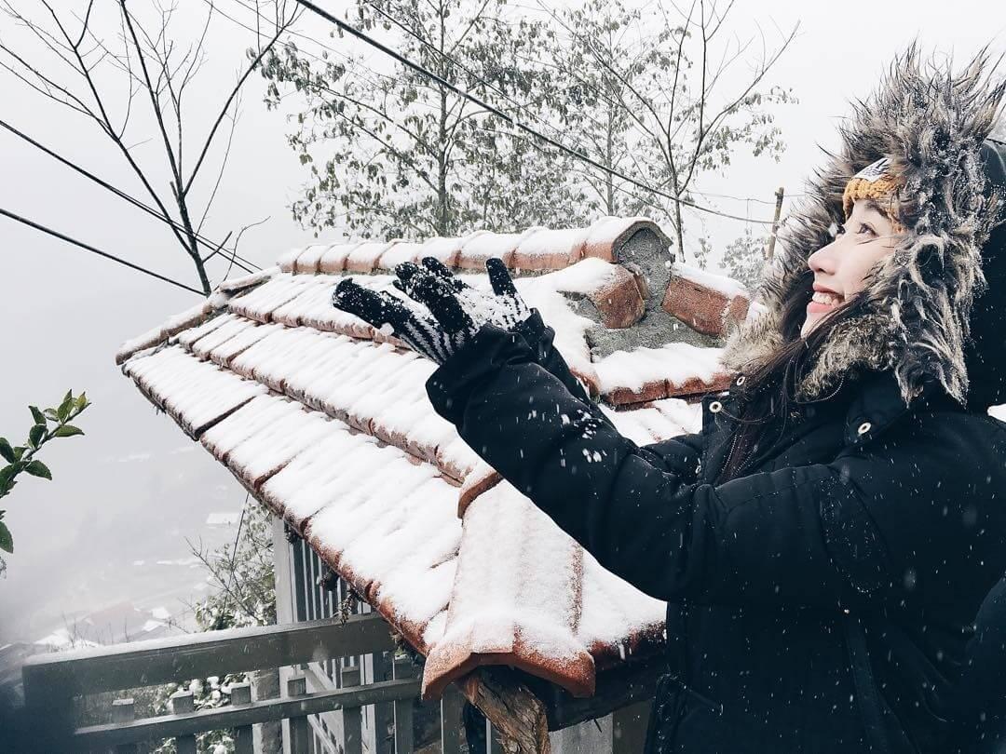
* EVERYDAY ENGLISH
2
Work in pairs. Make similar conversations with the following situations.
1. Student A is travelling to Sa Pa in winter. He / She doesn't know what to wear. Student B gives advice.
A: My family are going to travel to Sapa in this winter. But I don't know what to wear. Can you give me some advice?
B: Sure. The temperature in Sapa is very cold. You should bring winter clothing.
A: What clothes do you think I should bring?
B: Wool hats, jackets, gloves, scarves, jeans, warm coats, boots, ... I think you should also bring an umbrella or a raincoat because it snows a lot in winter there
A: I see ,thank you so much

Slide 8
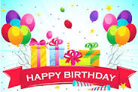
* EVERYDAY ENGLISH
2
Work in pairs. Make similar conversations with the following situations.
2. Student A is going to a birthday party. He / She doesn't know what kind of gift to bring. Student B gives advice.
A: Tomorrow is Nam's birthday. I don't know what kind of gift I should bring. Any ideas B?
B: I see that Nam is keen on playing sports. Why don't you give him trainers?
A: That’s a good idea. Thanks you

Slide 9
THE JAPANESE LION DANCE & VIETNAMESE UNICORN DANCE
3
Read the passage and choose the correct title for it.
The lion dance is called shishi-mai in Japanese. People perform it during New Year celebrations. Shishi-mai groups also perform at other important occasions such as business openings and weddings. Most forms of shishi-mai have one or more people performing the dance. The performers are excellent at acrobatics. One person controls the lion’s head and the other moves the lion’s body. The lion dances to the sounds of flutes and drums. The drummers and flute players often follow the lion around, but they do not dance with it.
The Japanese perform shishi-maito chase away bad spirits and to bring good luck.

Slide 10
THE JAPANESE LION DANCE & VIETNAMESE UNICORN DANCE
3
Read the passage and choose the correct title for it.
JAPANESE LION DANCE
Japanese name | (1) __________________
Occasions | – (2) _______________________ – other important occasions
Number of performers | one or more
Skills | (3) ____________
Dance partner | no dance partner
Musical instruments | (4) _______ and drums
Purposes | – to chase away (5) ____________ – to bring good luck
shishi-mai
New Year celebrations
acrobatics
flutes
bad spirits

Slide 11
THE JAPANESE LION DANCE & VIETNAMESE UNICORN DANCE
4
Work in groups. Read Mai’s notes on the Vietnamese unicorn dance. Compare the Vietnamese unicorn dance with the Japanese lion dance.
What are the similarities and differences between two pictures?

Slide 12
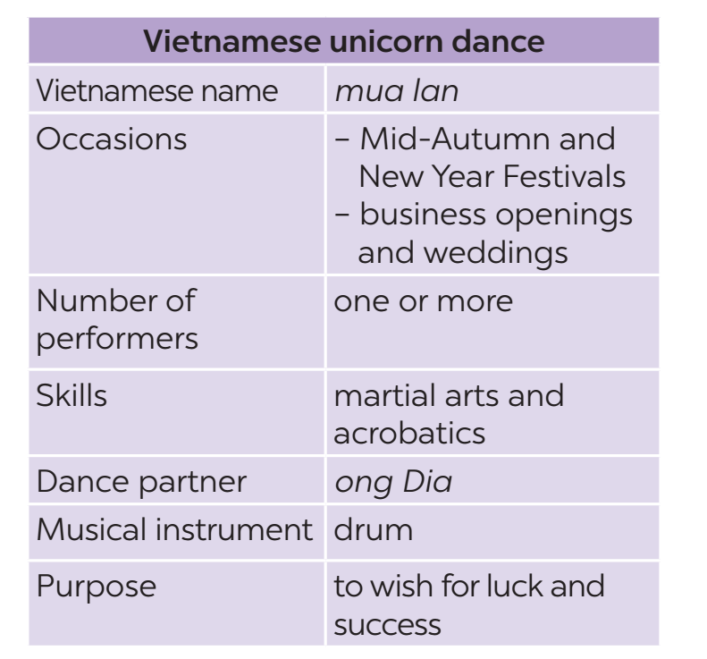
THE JAPANESE LION DANCE & VIETNAMESE UNICORN DANCE
4
Work in groups. Read Mai’s notes on the Vietnamese unicorn dance. Compare the Vietnamese unicorn dance with the Japanese lion dance.
Example:
The Vietnamese unicorn dance and the Japanese lion dance are both popular on New Year Festivals.

Slide 13
- There are one or more performers in both Vietnamese Unicorn dance and Japanese Lion dance.
- Both Vietnamese Unicorn dance and Japanese Lion dance perform in the New Year Festival.
- Vietnamese Unicorn dance needs Ong Dia but Japanese Lion dance doesn’t need it.
…

Slide 14
* CONSOLIDATION
In this lesson, we have learn to:
learn how to give advice
practise using some grammar points and vocabulary related to the topic.

Slide 15
* Homework
Do exercises in the workbook.
Compare Vietnamese Tet Holiday and Chinese Tet Holiday.

